Slide 1

Soft Skills
Interview Questions
Presented By:
Rashmi Singh
Jenny Jose
Krishna Vaghela

Slide 2

Checklist
01 | HR: What motivates you to do a good job?
02 | Technical: Why Data Analysis?
03 | Technical: Why Data Science?
04 | Conclusion
What we'll cover in this session

Slide 3


What motivates you to do a good job?
HR Question

Slide 4

Importance of this question
Understanding Work Ethic | Performance Predictability | Retention and Engagement | Potential for Growth
Overall, discussing what motivates you to do a good job allows employers to gain a deeper understanding of your character, work style, and potential fit within their organization. It's an opportunity to showcase your enthusiasm, commitment, and alignment with the company's goals and values

Slide 5
How you can put together a great answer to this question:
Reflect on your past experiences to figure out what motivates you.
Make sure your motivation is relevant and aligned with the position.
But be honest.
Stand out with a story.

Slide 6

Importance of motivation in workplace
01 Increased Productivity | 02 Higher Job Satisfaction | 03 Improved Employee Retention
04 Enhanced Innovation and Creativity | 05 Better Team Collaboration | 06 Increased Profitability

Slide 7
Challenges
01 Values Mismatch | 02 Lack of Self-Efficacy
03 Disruptive Emotions | 04 Attribution Errors

Slide 8
Ways to improve employee motivation in the workplace
To foster a positive work environment that promotes emotional well-being.
Provide regular feedback.
Support to employees.
Recognise and reward great work.
Encourage self-reflection and a growth mindset.

Slide 9
Why Data Analysis?
Technical Question

Slide 10
Data Analytics is a systematic approach that transforms raw data into valuable insights that can be used to make informed decisions.
What is Data Analytics?
Data analytics is important in business growth, performance optimization, risk management, and customer experiences.

Slide 11
Data analytics finds extensive application in various fields, including finance, agriculture, banking, retail, and government.
It serves as a powerful tool for driving informed decisions and fostering growth.
Data analysis simplifies the study of data, making it more accurate.
Researchers can interpret data straightforwardly, ensuring no valuable insights are overlooked.
Data analysis knowledge becomes essential for efficient and productive research as data volumes increase.
Applications and Impact

Slide 12
Skills required
Technical Skills | Statistical Programming Languages | Data Management Skills
SQL(Structured Query Language) - To handle large datasets. Spreadsheets | R Python | Data Cleaning and Preparation Data Analysis and Exploration Statistical Knowledge

Slide 13
Skills required
Data Visualization and Communication | Problem-Solving and Numerical Skills
Creating Data Visualizations: Creating Dashboards and Reports Writing and Communication Skills | Excellent Problem-Solving Skills Solid Numerical Skills Attention to Detail

Slide 14
Career growth
As a data analyst, you’ll be in high demand, contributing to business growth and efficiency.
Data analysts work in diverse sectors: finance, healthcare, marketing, tech, and more.
You can choose an industry that aligns with your interests and passions.
Data analysts can progress into roles like data scientists, business analysts, or project managers.
You’ll acquire proficiency in tools like SQL, Python, and data visualization platforms.
These skills are transferable and valuable in various domains.
Continuous skill development opens doors to exciting opportunities.

Slide 15
Why Data Science?
Technical Question

Slide 16
What is Data Science?
The term “data science” combines two key elements: “data” and “science.” Data: It refers to the raw information that is collected, stored, and processed. Science: It refers to the systematic study and investigation of phenomena using scientific methods and principles.
When we put these two elements together, “data+science” refers to the scientific study of data.
The goal of data science is to uncover patterns, trends, and relationships within the data to make informed decisions, solve complex problems, and create predictive models.

Slide 17

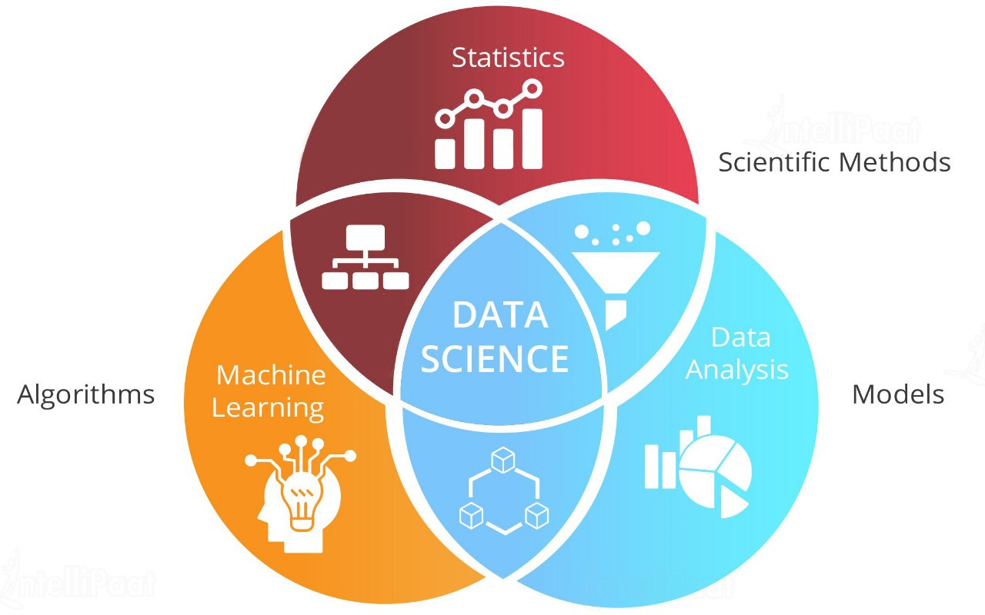

Slide 18
In today’s era, data is growing daily, and the world generates unprecedented amounts daily. Everyone depends on it to make decisions, improve work, and understand what’s happening. The key to making sense of all this data is Data Science.
Why is Data Science important?
It helps us find meaningful patterns and information hidden in massive and complicated data sets.

Slide 19
Pros
01 Multiple Job Options | 02 Business Benefits
03 Highly Paid Jobs | 04 Hiring Benefits

Slide 20
Cons
01 Data Privacy | 02 Cost | 03 Complexity

Slide 21
Conclusion
A good job is not just about the financial reward; it's about aligning with the company’s vision and values, feeling a sense of accomplishment and knowing that one's hard work contributed to a larger purpose.
Ultimately, staying motivated at work is about finding meaning in what you do and understanding how your role fits into the broader picture of the organization’s goals.

Slide 22
Conclusion
Data science and data analysis are integral parts of the modern analytical landscape, each playing a distinct role in extracting insights from data.
Data science is an evolving discipline that combines statistical methods, machine learning, and data analysis techniques to create predictive models and algorithms.
Data analysis, on the other hand, focuses more on processing and interpreting data to uncover trends and inform decision-making. It’s about turning raw data into actionable insights.
Both fields are crucial for organizations to harness the power of data and make informed decisions.

Slide 23

Thank you!

